Slide 1

Final Task
Written by Denis Aleksandrovich Mironov
PC specs: Gigabyte Z68AP-D3, Intel Core i7 3770, 4x8 Gb DDR3, SDD 180Gb + SDD 120Gb, GeForce GTX 1060

Slide 2
Table of context
1. Infrastructure schematics – slide №3
2. Prerequisites - slide №5
3. Router – hardware and software installation and configuration - slide №9
4. DB – hardware and software installation and configuration - slide №30
5. WEB – hardware and software installation and configuration - slide №43
6. Bash scripts - slide №49
7. Python script - slide №53
8. Simulation of MITM (Man In The Middle) Attack. - slide №57
9. Monitoring - slide №66

Slide 3
1. Infrastructure schematics
External
Vagrant management
Vagrant management
Vagrant management
NIC 1
NIC 2
NIC 1
NIC 1
WEB
ROUTER
DB
NIC 3
NIC 2
NIC 3
NIC 2
Intranet -1
Intranet – 2

Slide 4
Explanations:
- management network is different from the task’s requirement due to how Vagrant organizes it. Instead of one management network, it creates a separate management networks from the host to the guest machines. These networks are completely separated from each other and therefore guest machines cannot communicate through it between each other.
- Vagrant management networks always utilize NIC 1

Slide 5
2. Prerequisites
Software prerequisites to spin out the infrustructure
on Windows platform:
- Windows OS v. 7 – 11
- Virtual box
- Vagrant
- GIT
- Repository from GitHub

Slide 6
Installing Virtual Box
1. Go to website https://www.virtualbox.org/wiki/Downloads and download the latest version.
2. Install it using administrator credentials
3. Reboot your PC if prompted.
Installing Vagrant
1. Go to website https://www.vagrantup.com/downloads and download the latest 32 or 64 – bit version, depending on your OS.
2. Install it using administrator credentials
3. Reboot your PC if prompted.
4. Open advanced system settings using administartor credentials. (In latest version of Windows 10 open the system search, type there “advanced system settings” and click the result. Enter the administrator password.
5. In „Advanced“ tab click the “ Environment Variables” button.
6. Under the “System Variables” click the “New..” button and in the opened form type “VAGRANT_EXPERIMENTAL” in the “Variable name” field and “disks” in the „Variable value” field (both values should be typed without quotes).
7. Press “Ok” to close the form, press “Ok” again to close the window and close “System Properties” window.

Slide 7
Installing Git
1. Go to website https://github.com/git-for-windows/git-for-windows.github.io/blob/main/latest-64-bit-installer.url if you have 64-bit OS or https://github.com/git-for-windows/git-for-windows.github.io/blob/main/latest-32-bit-installer.url in case of 32-bit OS
2. Copy the download link in the “lines” field. For 64-bit os it should like similar to
“https://github.com/git-for-windows/git/releases/download/v2.34.1.windows.1/Git-2.34.1-64-bit.exe” .
3. Paste it into the address field of your browser and press enter to download Git installer.
4. Install git using administrator credentials (default settings should be ok)

Slide 8
Downloading (cloning) git repository of automated task.
1. Open a terminal app of your choice and navigate to the drive where you are going to work with the project. I going to use “S:” for this example.
cd s:
2. Create a directory where you are going to keep project’s files. For example, let’s call it “Project”
mkdir Project
3. Change a current directory to “Project”
cd Project
4. clone the git repository of the Final Task from github to the current directory
git clone https://github.com/Dealmi/E-M_FinalTask.git
5. Change into E-M_FinalTask directory
cd E-M_FinalTask
This is the directory where files for rolling out machines using Vagrant are situated.
6. Running the infrastructure :
vagrant up

Slide 9



3. Router machine
Routing
Elastic Stack
Elasticsearch
DNS server
Kibana
DHCP server
Elastic Fleet server

Slide 10
Network:
NIC #1: NAT – used as a control network between host and guest machines
NIC #2: Internal network between ROUTER and DB
NIC #3: Internal network between ROUTER and WEB

Slide 11
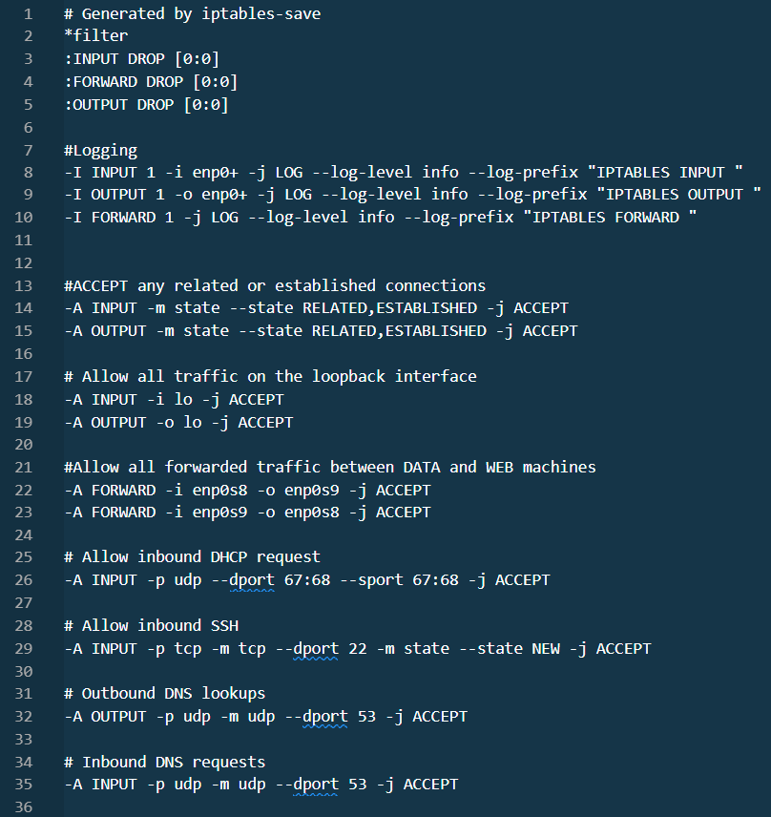
Firewall rules (file /etc/iptables/rules.v4):

Slide 12
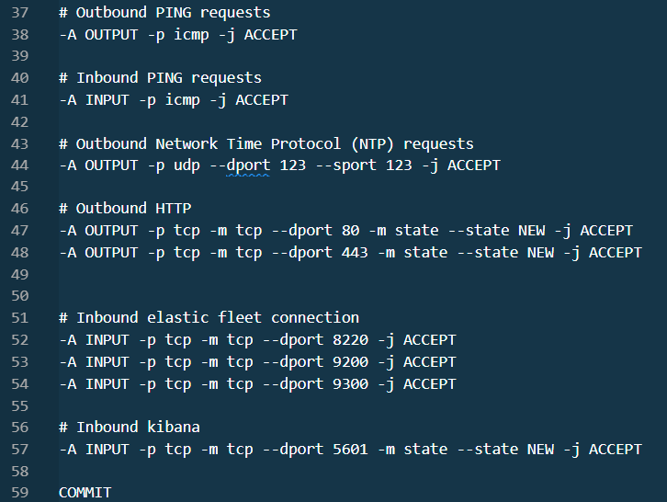

Slide 13
Routing
1. To enable the routing it necessary to enable the corresponding kernel option.
One of the ways is to add “net.ipv4.ip_forward=1” to the /etc/sysctl.conf .
It’s where kernel parameters can be stored.
sudo echo \"net.ipv4.ip_forward=1\" >> /etc/sysctl.conf
Then it is necessary to apply this kernel parameter by running
sudo sysctl -p
Another way is to set the kernel flag directly by issuing
sudo echo 1 > /proc/sys/net/ipv4/ip_forward

Slide 14
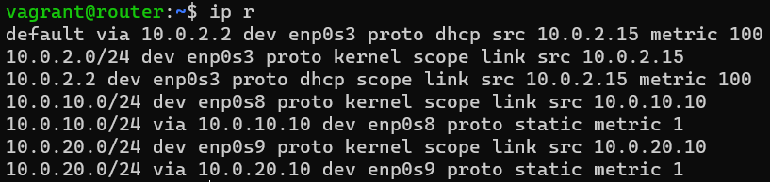
Routing scheme
ROUTER
10.0.20.x
10.0.10.x
10.0.20.10
10.0.10.10

Slide 15
DNS stands for “Domain Name System” and is the name service for Internet
addresses that translates friendly domain names to numeric
Internet Protocol (IP) addresses.
In Ubuntu bind9 server is used to perform DNS service.
The configuration of bind9 consists of 5 files: configuration file, options file,
and files containing A (direct) and PTR (reverse) records of machines
inside the DNS domain.
DNS server

Slide 16
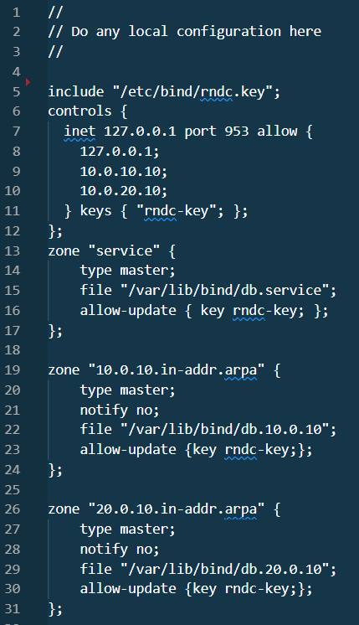
“named.conf.local” is the configuration file that goes inside /etc/bind

Slide 17
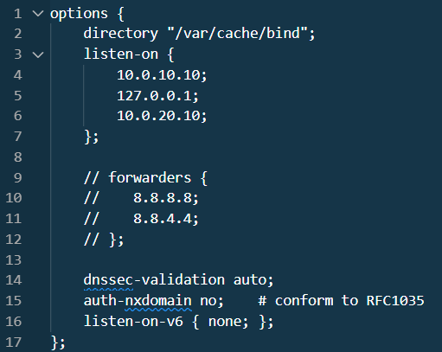
“named.conf.options” is the options file that goes inside /etc/bind too.

Slide 18
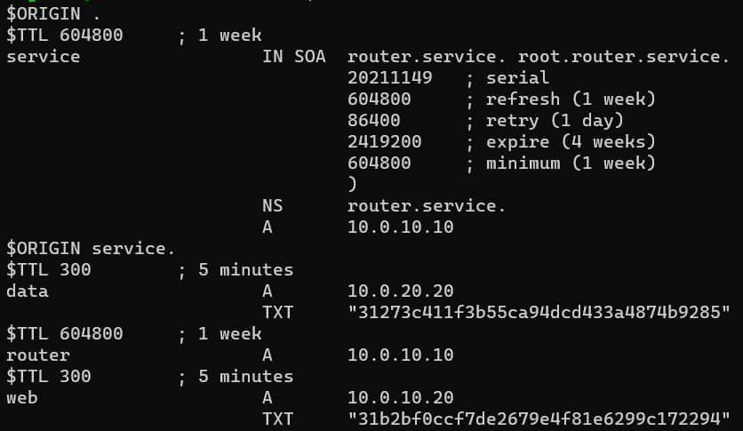
“db.service” – file containing A records in “service” domain zone.
It goes in /var/lib/bind

Slide 19
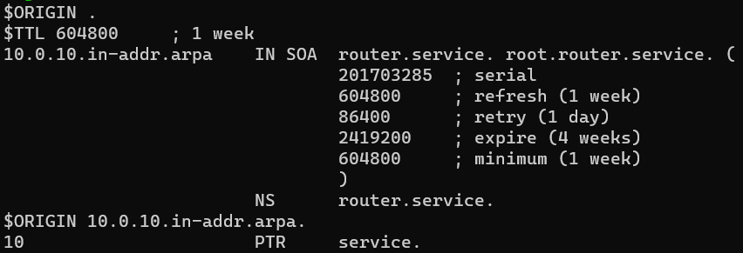
“db.10.0.10” – file containing PTR records in “service” domain zone
and in 10.0.10.0 subnet.
It goes in /var/lib/bind

Slide 20

“db.20.0.10” – file containing PTR records in “service” domain zone
and in 10.0.20.0 subnet.
It goes in /var/lib/bind

Slide 21
DHCP server
DHCP stands for Dynamic Host Configuration Protocol and is a client/server
protocol that automatically provides an Internet Protocol (IP) host with its
IP address and other related configuration information such as the subnet mask
and default gateway.
In Ubuntu one of the popular DHCP servers is isc-dhcp-server. It can work
In conjunction with DNS server by sending assigned IP addresses and
corresponding machines’ names to it in order for bind9 to automatically
adjust db* files as needed.
The configuration of isc-dhcp-server consist of 3 files: two configuration and one
key file are used for authorization purposes.

Slide 22
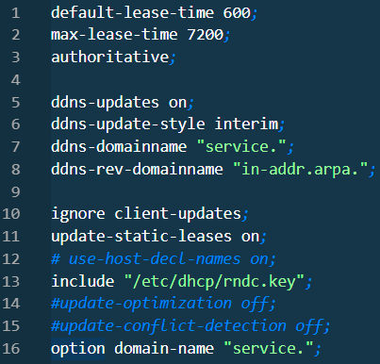
The configuration file dhcpd.conf goes to /etc/dhcp

Slide 23
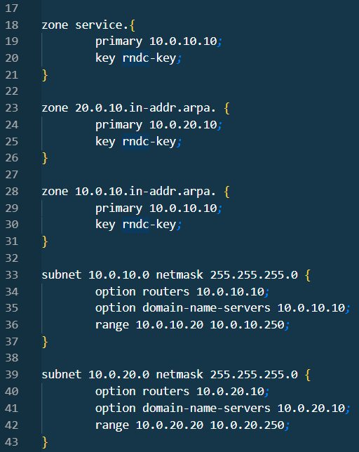

Slide 24
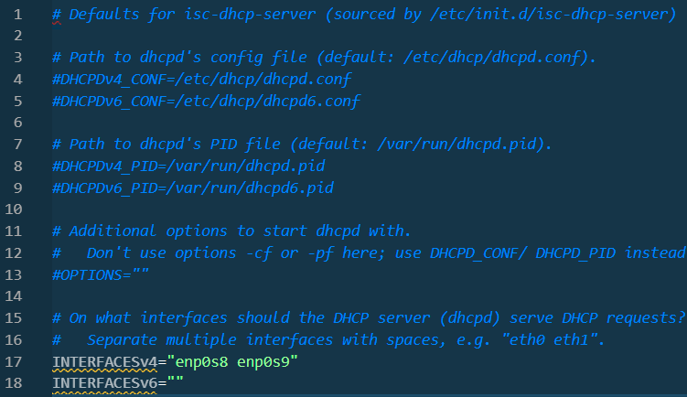
The file isc-dhcp-server is a configuration file with basic settings, such as
the location of dhcpd.conf file, PID file, interfaces binding etc.

Slide 25
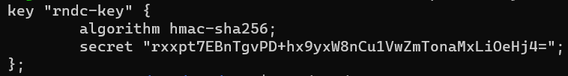
rndc.key is the special file required for authorization of the connection
of DHCP server to DNS server. It also used by rndc utility which can be used to
control DNS server through the command line. It contains settings such as a type of
encoding algorithm, the secret, the default ip address of DNS server, the default
port etc.
This file is generated by DNS server and can be regenerated manually.

Slide 26
Elastic Stack
A suit of software apps consisting of Elasticsearch, Logstash, Kibana and beats or agents, collecting different statistics, is usually referred to as Elastic stack or ELK stack.
Elasticsearch is a real-time, distributed storage, search, and analytics engine. Among many things, it excels in indexing streams of semi-structured data, such as logs or decoded network packets.
Kibana is an an open source analytics and visualization platform designed to work with Elasticsearch.
You use Kibana to search, view, and interact with data stored in Elasticsearch.
Logstash is an open source data collection engine. Logstash can dynamically unify data from disparate sources and normalize the data into destinations of your choice. It adds powerful data parsing and transformation features, but usually isn’t required.
In my infrastructure it is not used.
The Beats are open source data shippers that you install as agents on your servers to send operational data to Elasticsearch. Beats can send data directly to Elasticsearch or via Logstash, where you can further process and enhance the data. Most commonly used beats are nowadays transformed into Elastic agents for easier installation, management, and configuration through the Elastic Fleet server, which is used in my infrastructure.

Slide 27
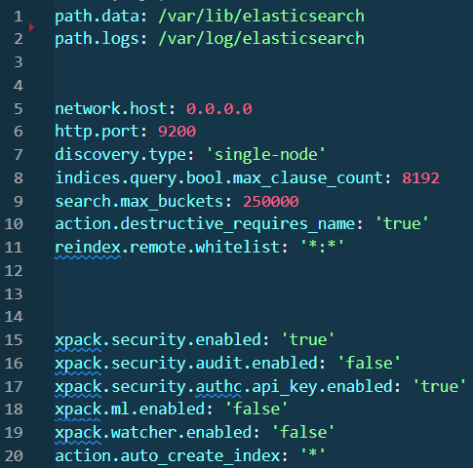
    Elastic stack setup comes pre-installed using the image I made specifically for that project in order for automation to work correctly.
    Elasticsearch config file is located at /etc/elasticsearch/elasticsearch.yml . In it we can set options such as network settings, database settings, search settings, security etc.

Slide 28
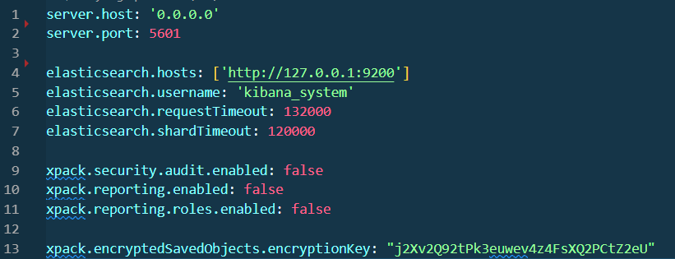
Kibana’s config file is situated at /etc/kibana/kibana.yml. In it we can set network
settings, security, encryption key to connect to Elasticsearch etc.

Slide 29
Elastic Fleet consists of Elastic Fleet server and elastic agents, connecting to it.
Elastic fleet works as a collector of data from agents as well as an agent for the local
server, where it’s installed. All configuration is done via Kibana web-interface.
In it, one can configure settings such as network, agents management and control,
data collection integration, which collects data from multiple sources etc.
Collected data is then stored in elastic search database, so that one can access it
In several ways, including Kibana to access information and represent it in
a nice graphical form.

Slide 30

4. DB machine
LVM dev1
      dev2
mdraid (RAID-1) dev1 dev2
database server
Elastic agent

Slide 31
Network:
NIC #1: NAT – used as a control network between host and guest machines
NIC #2: Internal network between ROUTER and DB

Slide 32
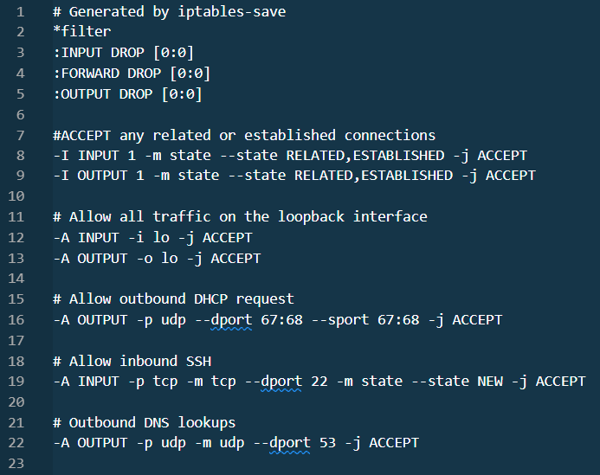
Firewall rules (file /etc/iptables/rules.v4):

Slide 33
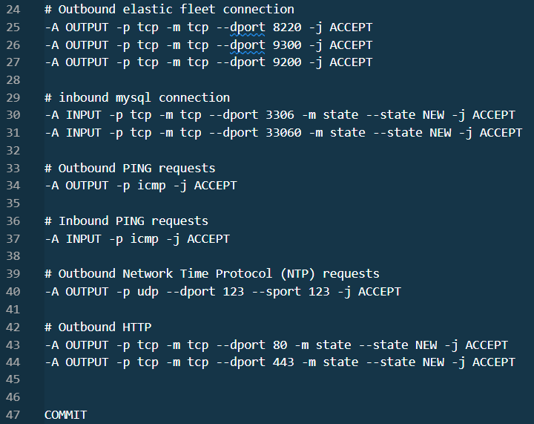

Slide 34
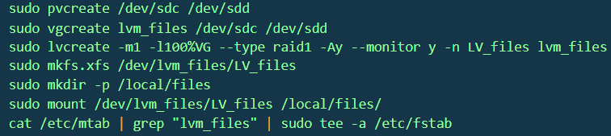
Creating LVM volume:
1. Create physical volumes
2. Create a volume group
3. Create a logical volume
4. Create a file system in this volume and mount it to the user-defined directory.
5. Add the corresponding record to fstab to mount it during the boot-up

Slide 35
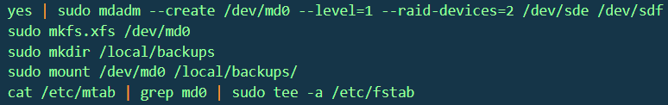
Creating a software RAID (type 1):
1. Using the mdadm utility create a raid volume out of two disk devices
2. Create a file system on this raid volume
3. Mount this file system accordingly
4. Add the corresponding record to fstab to mount the file system at boot-up time.

Slide 36
MySQL database server
MySQL is an open source SQL database management system. All databases in it are relational and they store data in separate tables. The creator of databases sets up rules governing the relationships between different data fields, such as one-to-one, one-to-many, unique, required or optional, and “pointers” between different tables.
The SQL part of “MySQL” stands for “Structured Query Language”. SQL is the most common standardized language used to access databases.

Slide 37
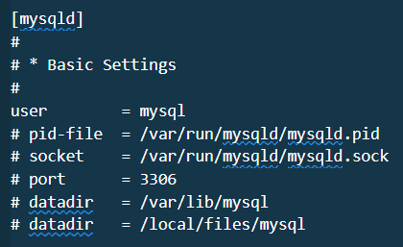
Main configuration file for MySQL server is /etc/mysql/mysql.conf.d/mysql.cnf .
It contains basic connection, file and logging settings such as ip address, port,
whereabouts of log files, location of data bases etc.
More in-depth options are stored in the database called “mysql”. Where you
can find user accounts, access settings, character set, collation etc.

Slide 38
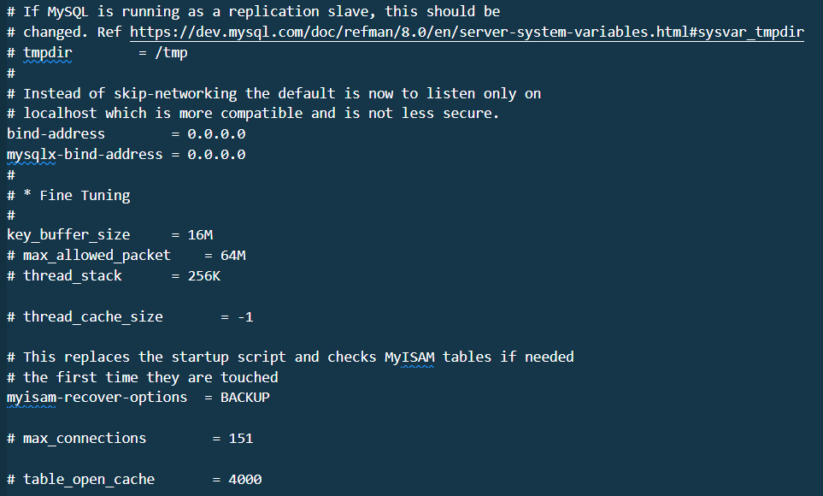

Slide 39
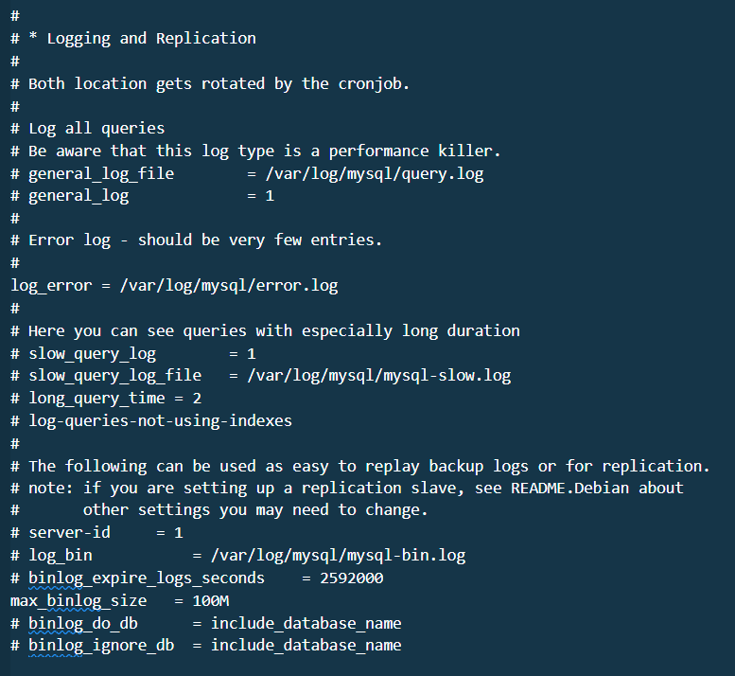

Slide 40

MySQL server settings stored in a special database along with the
database for the web application are imported from two custom files “mysql.sql”
and “webapp.sql” using following bash commands:

Slide 41



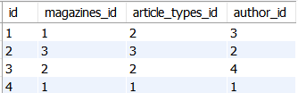
Tables in the “webapp” data-base looks as follows:
magazines
article_types
author
Articles

Slide 42
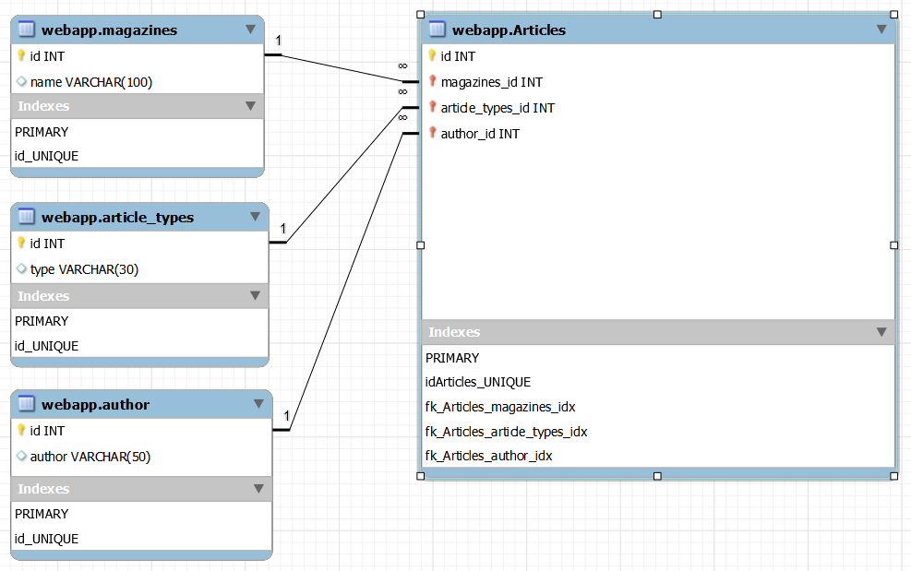
This is the relations schematics between tables:

Slide 43


5. WEB machine
NGINX
web-server
Python
Elastic agent

Slide 44
Network:
NIC #1: NAT – used as a control network between host and guest machines
NIC #2: Internal network between ROUTER and WEB

Slide 45
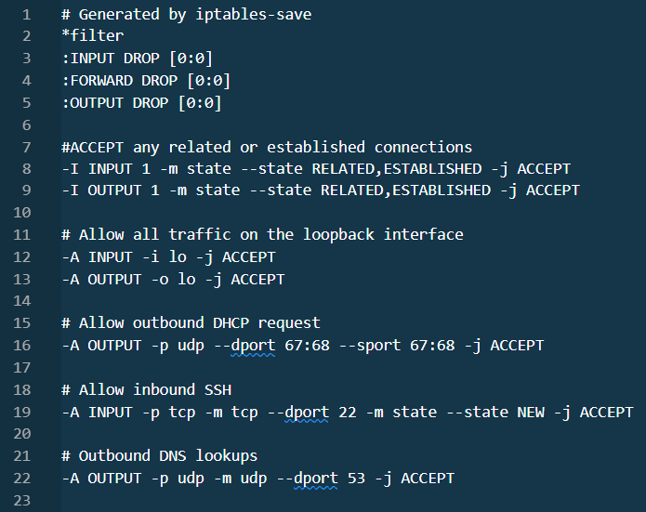
Firewall rules (file /etc/iptables/rules.v4):

Slide 46
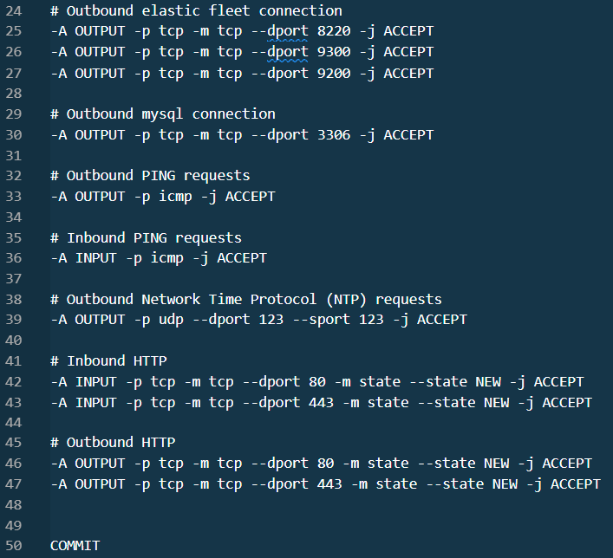

Slide 47
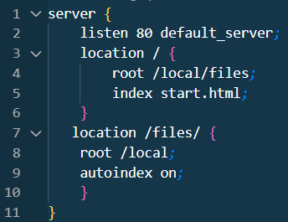
website.conf (placed in /etc/nginx/sites-available/) is
a configuration file for the web app
NGINX web-server
    NGINX is an open source web server and application delivery controller.
  In my project it functions as a web-server.

Slide 48

Default starting web-page is start.html, placed inside the /local/files/ directory.

Slide 49
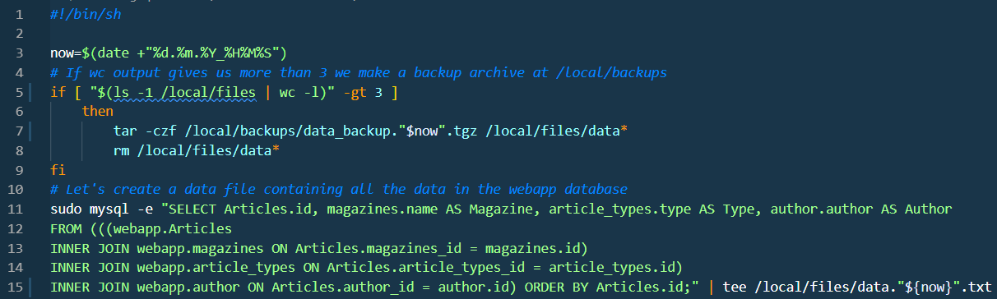
6. Bash scripts
№1. Retrieves data from the database and stores it in files. It also compresses extra files in archives.
  “dataRead.sh”

Slide 50
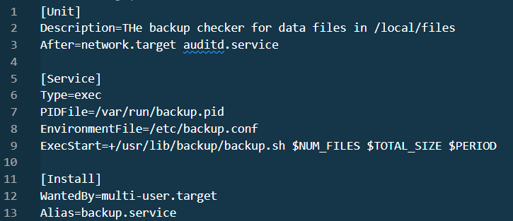
№2. This script works in detached mode and starts at system boot and has its pid file.
It sends mail to root about number of files and total size of files in /local/backup directory
based on the configuration. This script consist of 3 files: service file, config file
and shell-script file. This ensures that the script is running as a service with provided
parameters and only as a single instance
File #1 – service file “backup.service”. It is placed in /etc/systemd/system

Slide 51
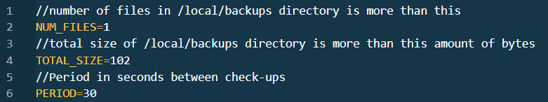
File #2 – config file “backup.conf”. It is placed in /etc/

Slide 52
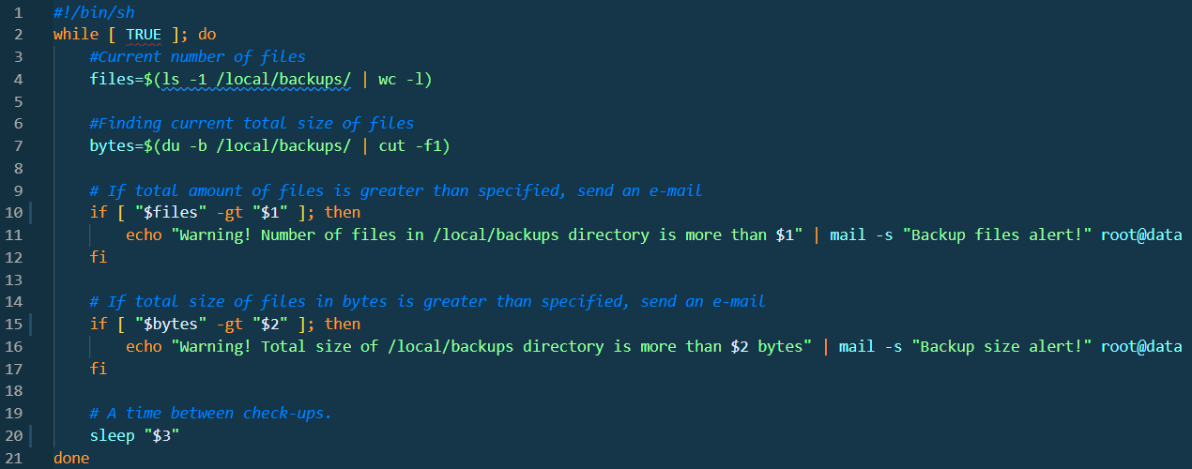
  File #3 – shell script. It is placed in /usr/lib/backup (“backup” directory
needs to be created)

Slide 53
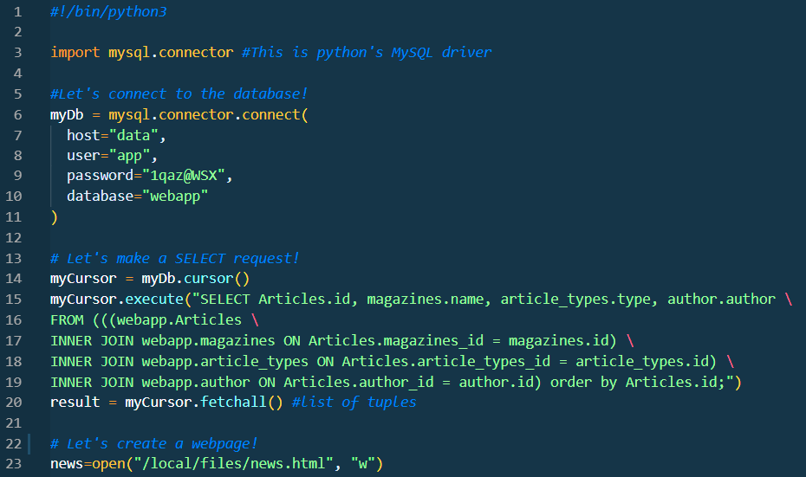
7. Python script
  Python script “getData.py” is added to cron. It generates a web-page for a web-server using data from the database server.

Slide 54
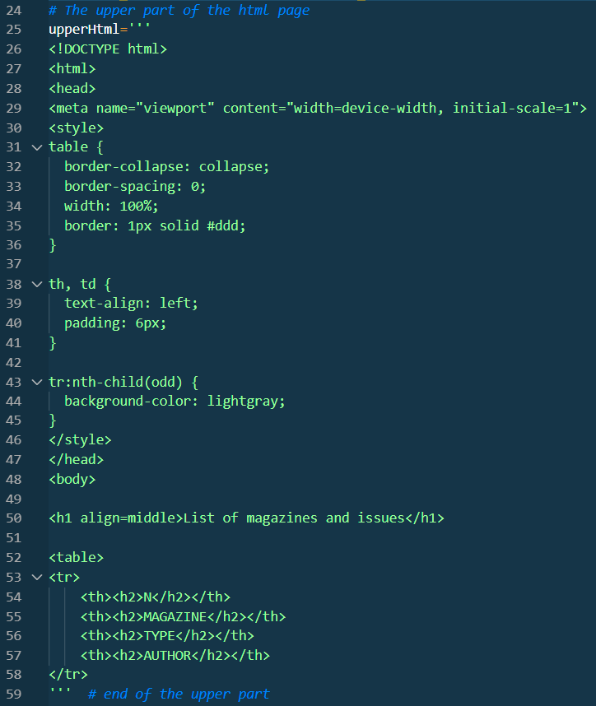

Slide 55
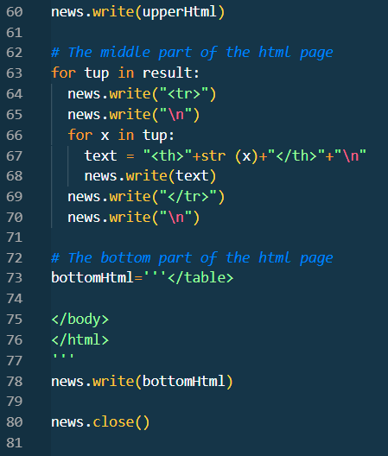

Slide 56
Cron configuration file “webnews” for the Python script is placed in /etc/cron.d/
The python script is placed inside the /local/scripts directory and
launched every 5 seconds. It creates a web-page file: /local/files/news.html

Slide 57
8. Man in the middle (MITM) Attack
  Man-in-the-Middle is the type of cyberattack, where a hacker inserts his pc between two
  parties and gains access to the information that the two parties were trying to share.
  Usually, a man-in-the-middle attack has two phases: interception an decryption.
  1) Interception: an intruder is gaining an access to a network, usually through a poorly secured
  router. The goal is to find weak passwords, but they also can perform an IP spoofing or cache
  poisoning. IP spoofing is a creation of Internet Protocol (IP) packets which have a modified
  source address in order to either hide the identity of the sender, to impersonate another
  computer system. Cache poisoning is a type of cyber attack in which attackers insert fake information into a domain name system (DNS) cache or web cache for the purpose of harming users. Once the access is obtained, the victim’s data will be collected using capture tools.

Slide 58
2) During decryption the intercepted data is decoded and ready to be used for the
malicious purposes.
In my project it is assumed, that the unauthorized access has been gained and
we are at the second stage of capturing data coming from the WEB machine to DB.
Capturing data is performed by wireshark – a packet capturing utility with
simple terminal-based UI called termshark.
First, we are going capture the non-encrypted traffic coming to the port 80. Then we going
to use ssl certificates for encryption of the web-traffic which will be rerouted to
standard port 443. Afterwards we are going to try to capture the web traffic again.

Slide 59

1.1. Nginx configuration without encryption.
1.2. Using bash command curl http://web we receive a following response :

Slide 60
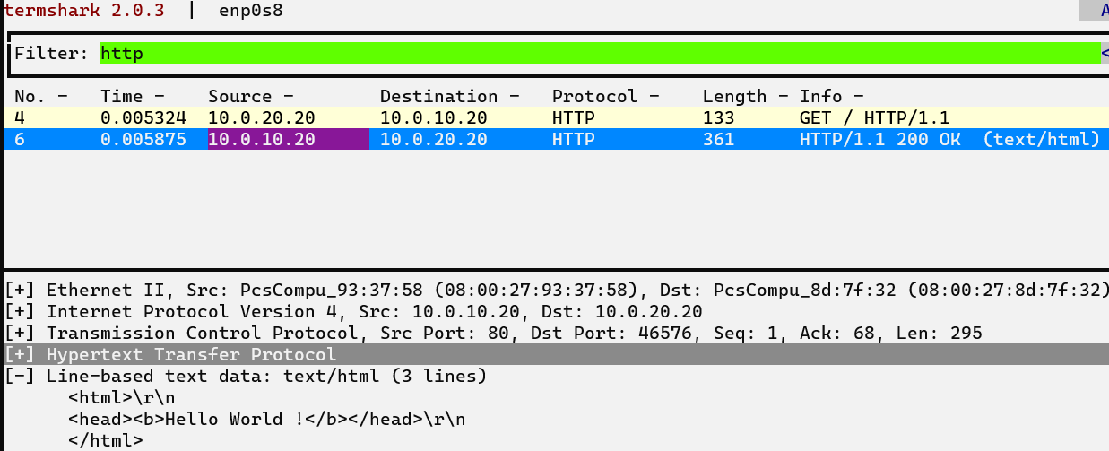
1.3. On the ROUTER machine let’s run a packet capturing application termshark using the following command: sudo termshark -ienp0s8 . Using “http” as a filter in order to view only records relevant to http protocol traffic, we end up with the following screen:
In the upper half of the screen, we can see two lines: 1st is the page request by curl and
2nd is the response to this request by Nginx. In the bottom part we can see a context of
transmitted web-page with the “Hello World” content. Interception is successful!

Slide 61
Now let’s prevent the interception by using an encryption! This is what needs
to be done:
1. Generate self-signed SSL\TLS certificate and a private key
2. Change Nginx configuration, using files from the 1st step.
SSL stands for secure sockets layer. The newer protocol is TLS, or transport layer security. These are web protocols used to wrap normal traffic in a protected, encrypted wrapper. In order to generate a pair of public certificate and a private key we shall use an openssl utility.
Openssl is the tool for creating and managing OpenSSL certificates, keys, etc.

Slide 62
1.Executing the following command will produce us the requred pair of files:
sudo openssl req -x509 -nodes -days 365 -newkey rsa:2048 -keyout /etc/nginx/ssl/webnews.key -out /etc/nginx/ssl/webnews.crt
During the process the tool will ask you different question, where the most
important one is about FQDN or IP address of the server.
This is a breakdown of keys used to invoke openssl:
-req: This subcommand specifies that we want to use X.509 certificate signing request (CSR) management.
-x509: This further modifies the previous subcommand by telling the utility that we want to make a self-signed certificate instead of
generating a certificate signing request
-nodes: This tells OpenSSL to skip the option to secure our certificate with a passphrase. We need Nginx to be able to read the file,
without user intervention, when the server starts up.
-days 365: This option sets the length of time that the certificate will be considered valid.
-newkey rsa:2048: This specifies that we want to generate a new certificate and a new key at the same time. The rsa:2048 portion tells it to
make an RSA key that is 2048 bits long.
-keyout: This line tells OpenSSL where to place the generated private key file that we are creating.
-out: This tells OpenSSL where to place the certificate that we are creating.

Slide 63
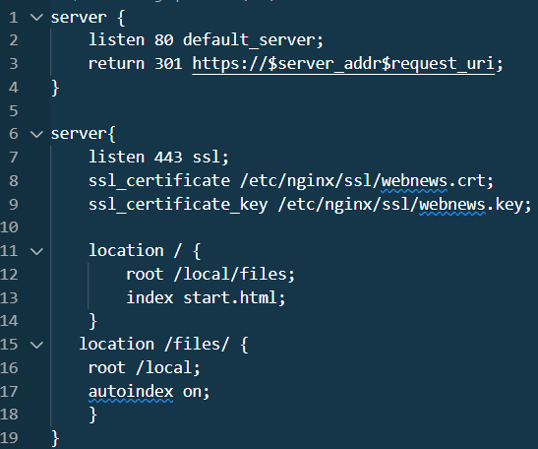
2. Now let’s modify Nginx site configuration so it will use certificate and a key file
provided in a previous step.
Encrypted traffic will be accepted by default on port 443 and should user tries to
access port 80, configuration insures the redirection of a traffic to port 443.

Slide 64
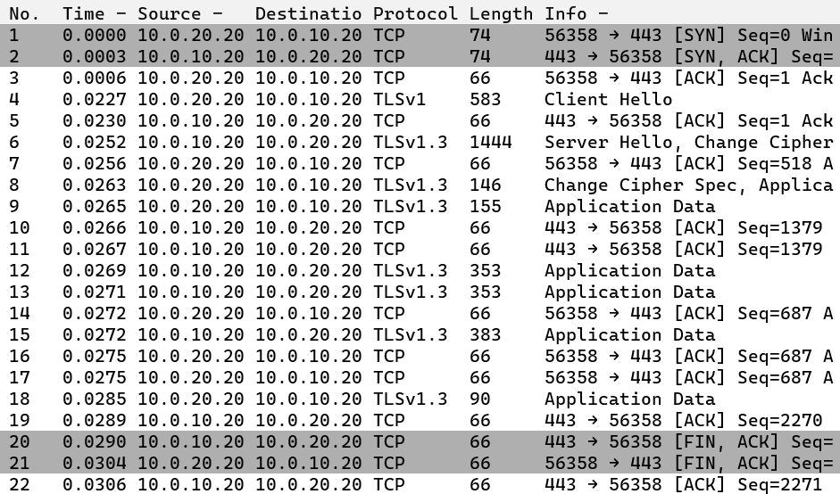
Now let’s try to intercept the web traffic again using termshark while launching a following curl command: curl https://web -k . The key “-k” is for accepting unverified certificates.

Slide 65
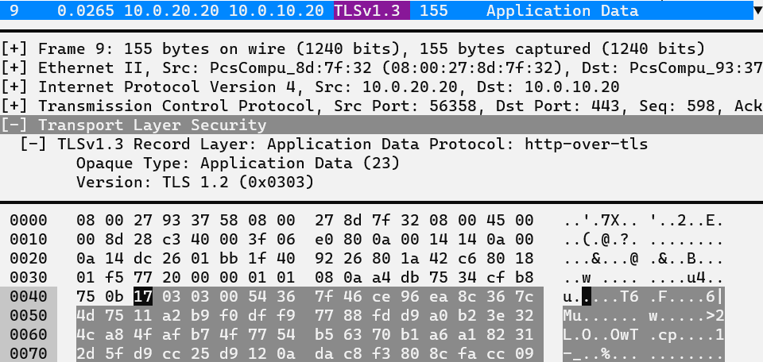
As we can see, the connection between the client and the web-server is secured using TLS 1.3 protocol. If we try to see a content of packets, we will not be able to do so anymore. Interception has failed!

Slide 66
9. Monitoring
1. Basic Linux host resource utilization.
a) To see a CPU utilization, launch top app in the console. You will get results similar to the following:
Main parameters here are load average and “%Cpu(s)”. Load average numbers show the combined
amount of processes that are either being executed or in the waiting queue over the one, five and fifteen minutes.
“%Cpu(s)” showing the percentage of CPU time usage by different types of resources. ”Us” amount of time, taken
by processes executed in the user space, “sy” is the time taken by the system owned processes, “ni” is the time
taken by processes with the manually modified priorities, “id” is the idle time, “wa” - time the CPU spends
waiting for I/O to complete, “hi” is the amount of time spent servicing hardware interrupts, “si” – same as with “hi”,
but regarding software interrupts and finally, “st” is a so-called “stolen time” – the time borrowed by other VM’s.

Slide 67
b) To see a memory utilization one can use the utility called free. This is what its output looks like:
“Mem” string shows statistics of memory, while “Swap” string shows statistics regarding swap area.
Meaning of columns (all figures are in bytes):
- total: total amount of memory
- used: total memory minus allocated free, shared, buffer, and cache memory.
- free: completely unused memory
- shared: memory used by kernel\system needs, usually libraries.
- buff\cache: memory also used by kernel\system needs , usually set aside for use before it’s
needed to improve performance.
- available: the amount of memory is still available for use.

Slide 68
c) Disk (IOPs) can be determined using iostat <device> command. This is how its output might look like:
Device – system name of the device
tps – number of transfers (I/O requests) per second to the device
kB_read/s – amount of data read from the device in kilobytes per second
kB_wrtn/s – same as above, but for written data
kB_dscd/s – amount of data discarded for the device per second
kB_read – total number of kilobytes read
kB_wrtn – total number of written kilobytes
kB_dscd – total number of kilobytes discarded

Slide 69
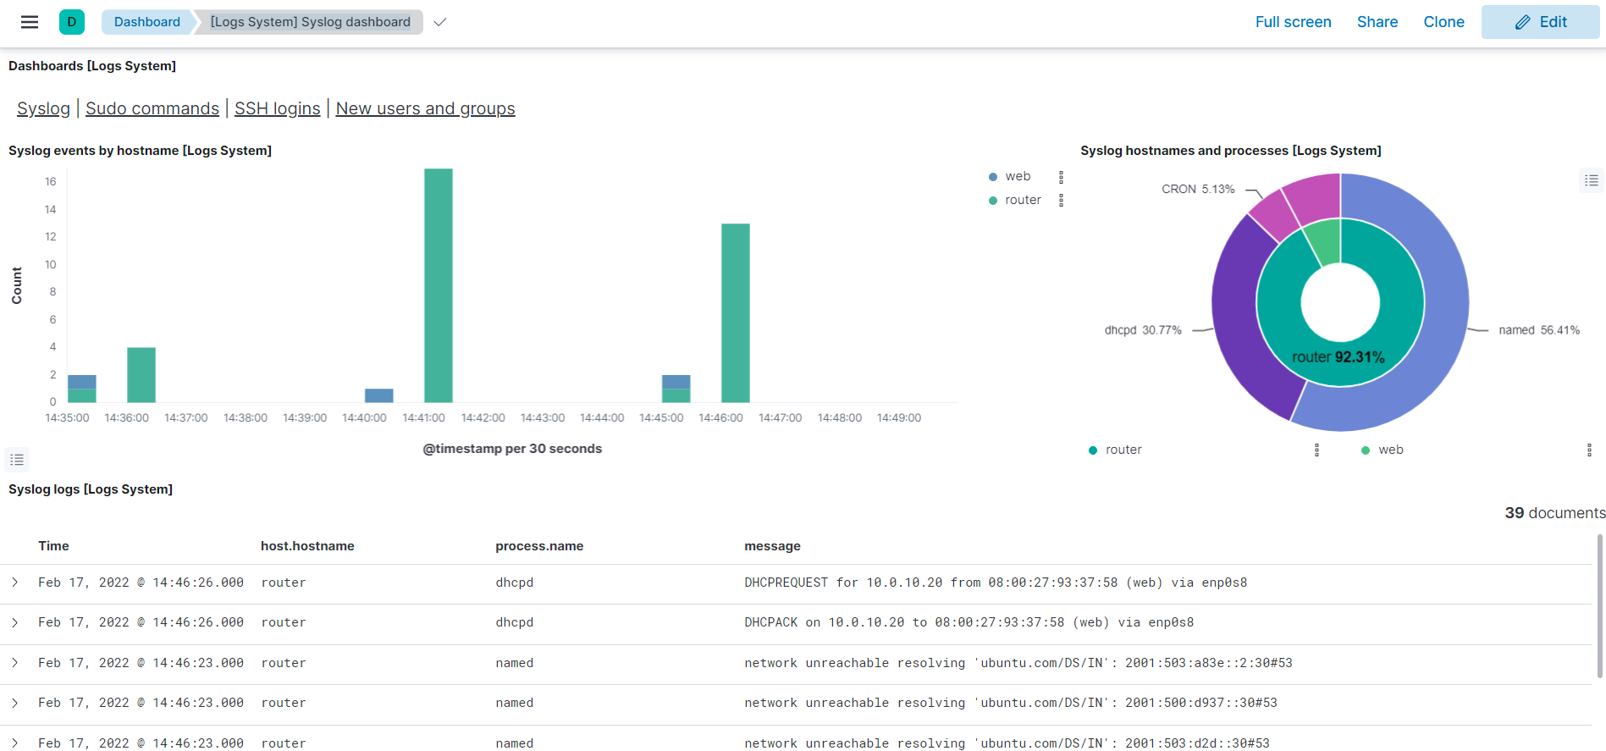
d) This is how to see collected system logs using ELK stack. From main menu select “Overview” >
“Dashboard”> “[Logs System] Syslog dashboard”

Slide 70
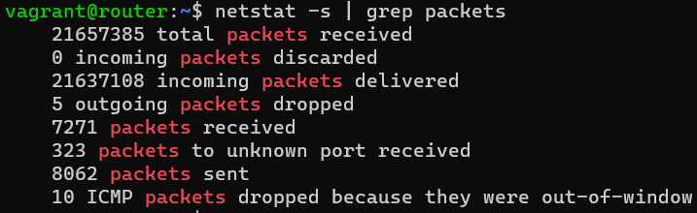
2. Network monitoring
To see TCP sessions established, issue netstat -s -t | grep established command.
To see packet counters (IN/OUT/DROPPED) issue netstat -s | grep packets
The output will be something like this:
Top half before the second “packet received” is statistics regarding tcp proto and below – regarding udp

Slide 71

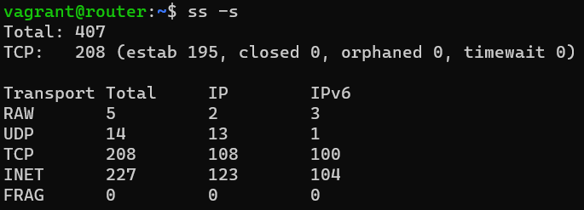
Netstat -s | grep err command will show errors during packet transmissions.
Netstat -s | grep forwarded command will display the amount of forwarded packets
To see a network utilization by protocols, issue a ss -s command

Slide 72
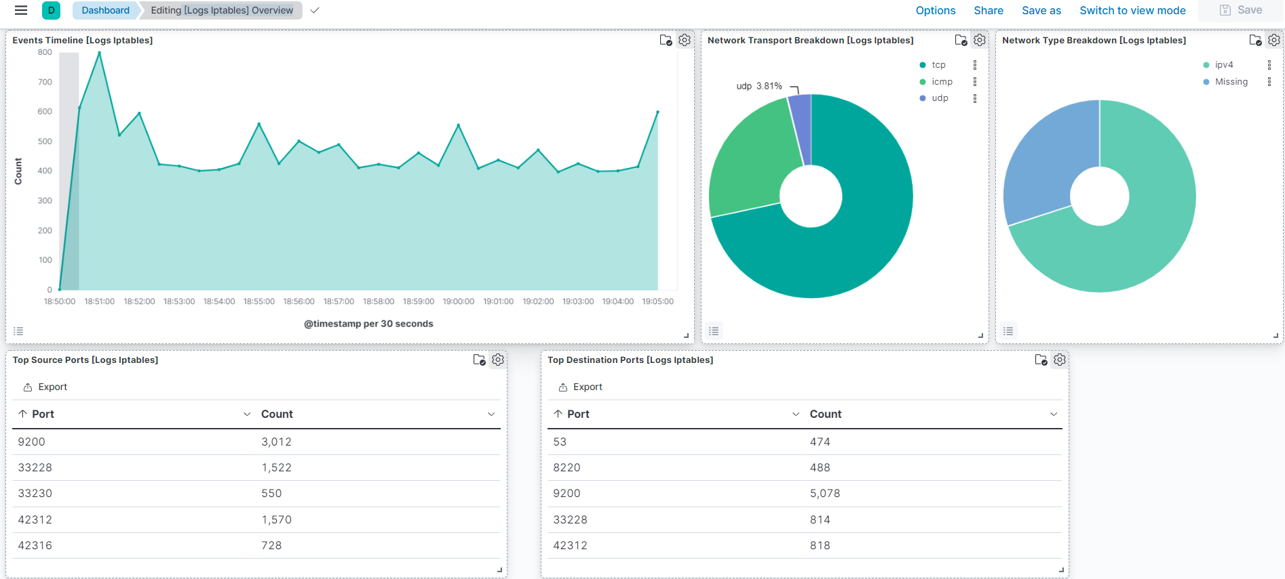
To see a retrospective of network utilization in a graphical format using ELK stack we should use the
Iptables integration for the fleet agent. After incorporating the aforementioned integration we can see
statistics using [Logs Iptables] Overview dashboard.

Slide 73
